Slide 1


By
Dr. Anand Sapre

Slide 2
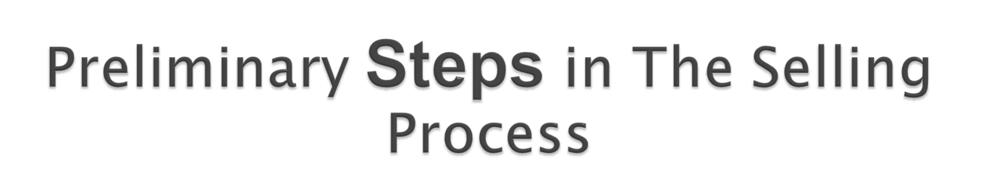

PROSPECTING
PREPARING

Slide 3


PRENSENTING
HANDLING OBJECTIONS
CLOSING
FOLLOWUP

Slide 4


Indentifying Prospects
Qualifying Prospects

Slide 5


Pre-approach
Call Planning

Slide 6


Approach
Probe for Needs
Convince the Prospect

Slide 7



Type of Objections
Responding to Objections

Slide 8


When to Close
How to Close

Slide 9


Post Sale Activities
Self Analysis

Slide 10

YOU THINK
THANK YOU

